Slide 1
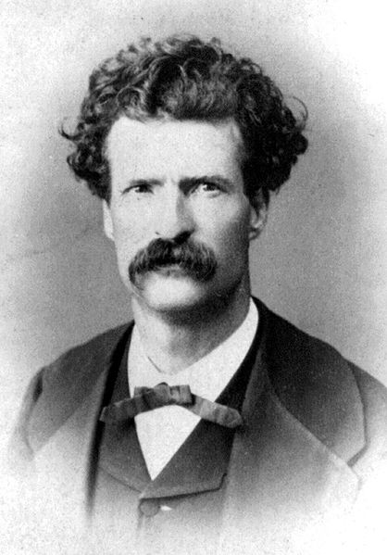
Mark Twain
Samuel Clemens

Slide 2
The Adventures of Huckleberry Finn
The Great American Novel

Slide 3
Mississippi River steamboat pilot
Mark Twain – river depth of two fathoms
Pen Name

Slide 4
Familiar with life in the South
Culture
Slavery
Constantly writing

Slide 5
Love of technology
New printing press
Great financial troubles: ~8 million in debt
Depression after daughter died of meningitis

